Slide 1
TG MACRO Conference call #5
March 28, 2018

Slide 2
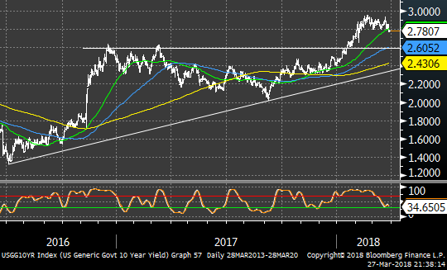
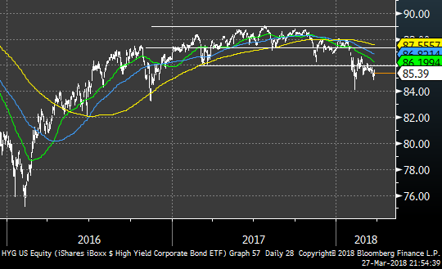
US 10Y Yields High YIELD
THE BOND BREAK

Slide 3
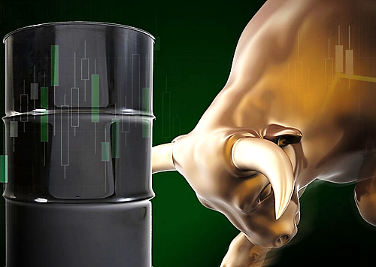
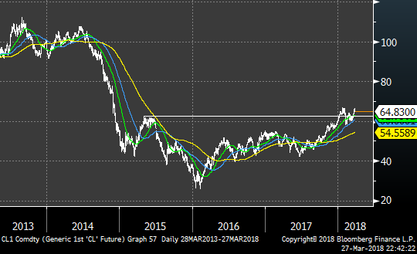
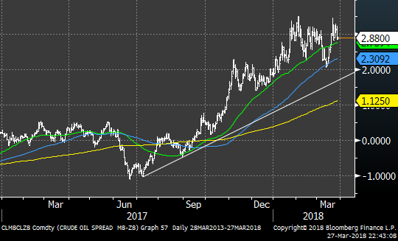
Futures Spreads
The Oil Situation

Slide 4
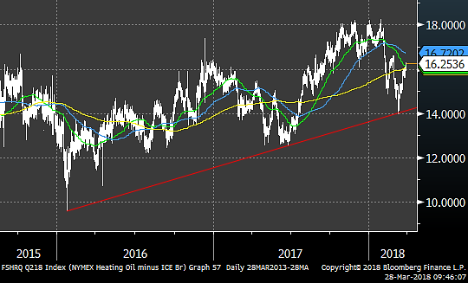
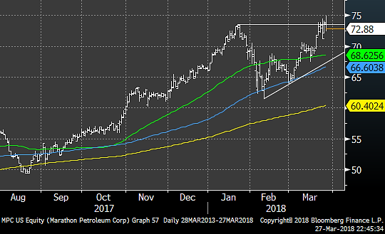
CRACK SPREADS Marathon man
The Oil Situation

Slide 5
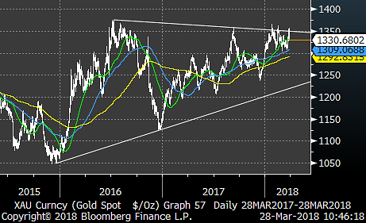
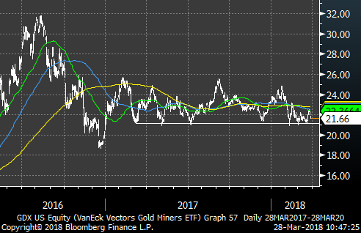
GOLD Gold Miners
The Gold Situation

Slide 6
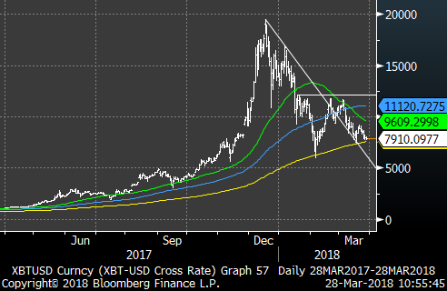
A 200dma break could be the death of it
Bitcoin Looks Badcoin

Slide 7
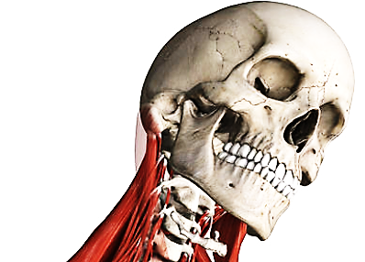
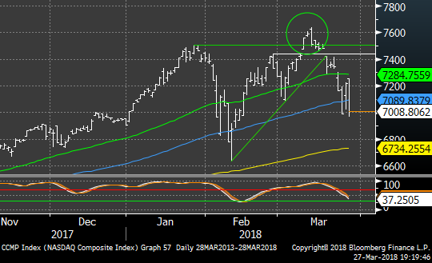
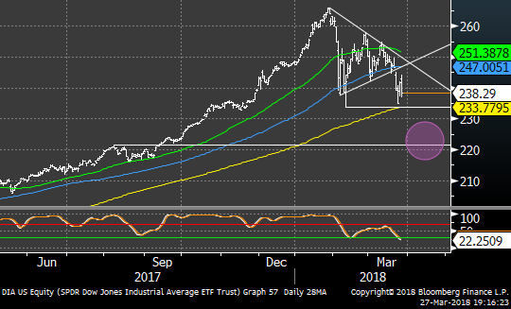
NASDAQ DOWN JONES
THE INDICES

Slide 8
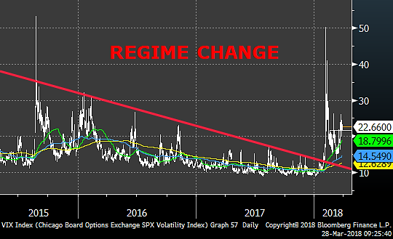
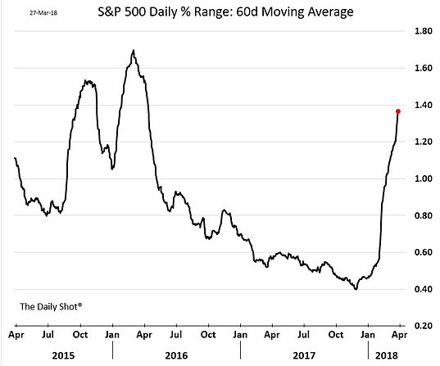
And the return of volatility …at long last
THE INDICES

Slide 9
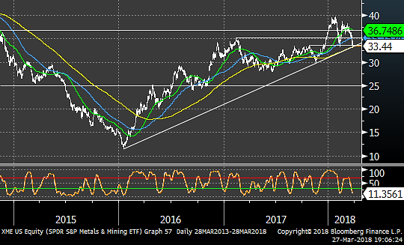
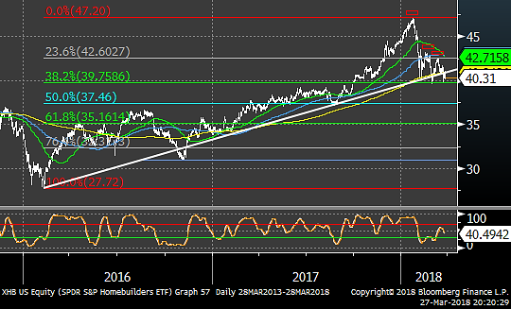
xME xHB
THE SECTORS

Slide 10
Dismantling TECH
The damage was severe

Slide 11
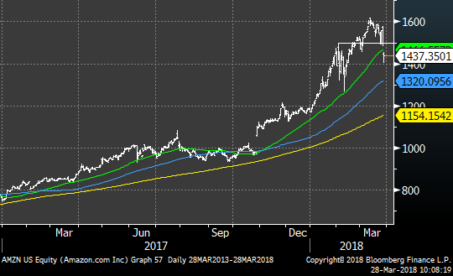
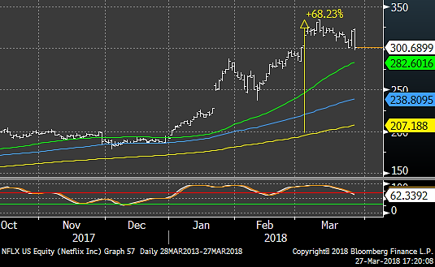
AMZN & NFLX – unbroken

Slide 12
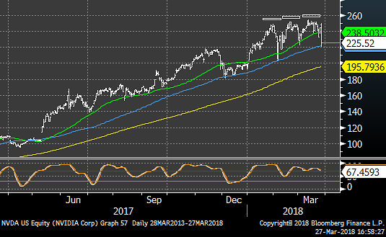
NVDA – Nvidia put itself into technical Jail

Slide 13
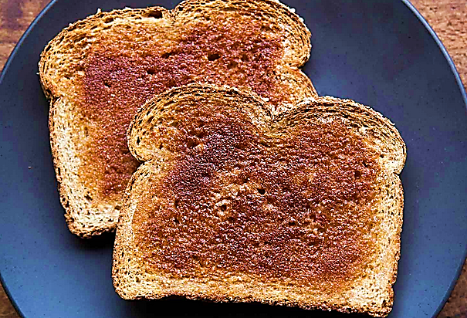
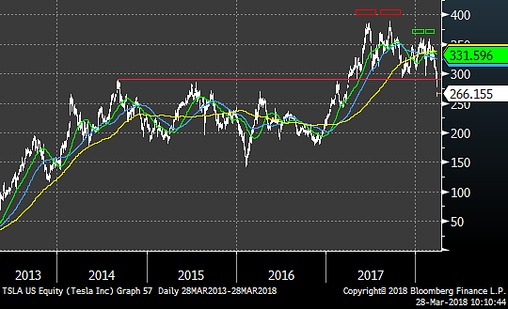
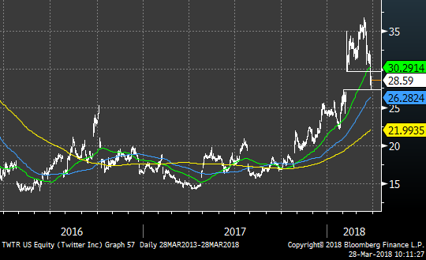
TSLA & TWTR ARE TOAST

Slide 14
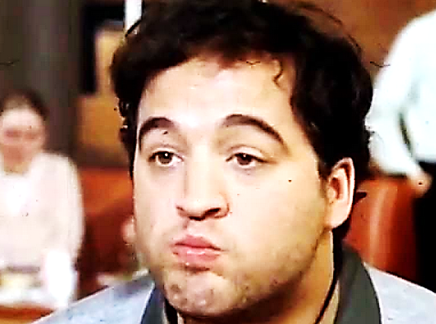
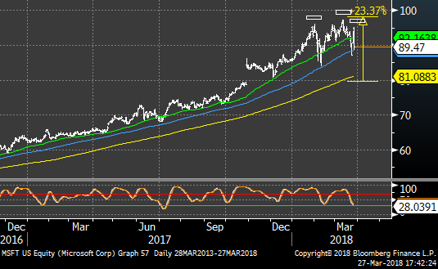
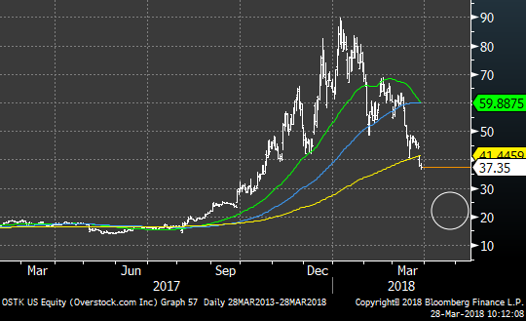
Microstuffed and Overstocked

Slide 15
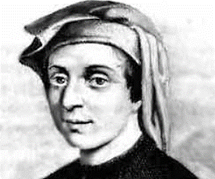
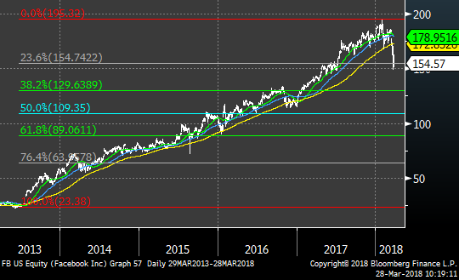
THE FIBONACCI OF FACEBOOK
Fibonacci Retracements of FB’s move from $23 to $195.20:
38.2% $129.70
50% $109.35
68.2% $89.00 Place yer bets…

